Slide 1


Day 04
contact@anubhavtrainings.com
ABAP RESTFUL APPLICATION PROGRAMMING

Slide 2

Agenda – Day 04
Local Types/Classes in ABAP with Global Classes
Implementing Class Pool Concept
Behavior Definition Introduction
Create Behavior Definition
Create Behavior implementation for Unmanaged Scenario
What is EML ?
Why we use EML
Syntax of EML
C-R-U-D Using EML
Implementation of EML
Introduction to Managed Scenario
Use Case for Managed Scenario
Describing Functionality of Scenario
Sequence Diagram
Implementing Create, Update and Delete
Make field read only
Making field Mandatory
Add validation to the code
Implement Actions - set_status_booked
Notes:
Managed Implementation – Demo Scenario
Projections
Flexible service consumption
Development flow – managed scenario
Implementation for processor scenario
Final processor Fiori App
Recap and Testing Composition
Implementing the Action createTravelByTemplate
Implementing the Action approveTravel
Implementing the Action rejectTravel
Modeling Static and Dynamic Feature Control
Implementing Validations
Implementing the Determination

Slide 3
Local Types/Classes in ABAP with Global Classes
Local Types for Global Classes - Within class pools, as in virtually any other ABAP program, data types, local interfaces, and local classes can be defined to ensure a better structure of the implementation of the global class.
More number of classes will cause confusion and over-modularization increase the complexity of our design
More number of global classes, will increase the chance of our code being exposed to reports/classes which we may want to use only a private
Allow a modularized way of designing app but still keeping our code in a single contain, a good balance between number of classes v.s modularization.
At times we need so many classes for different purpose with very limited no of methods. 2 meh. + 20 classes, Create a class pool would be a good options.

Slide 4
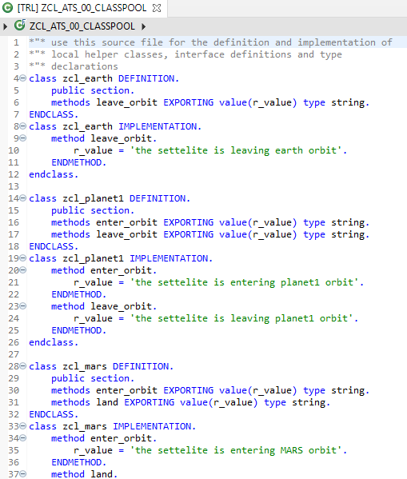
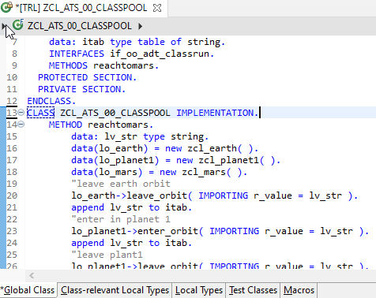
Implementing Class Pool Concept
Global Class
Exercise
Class Pool Code
Local Types/Class

Slide 5
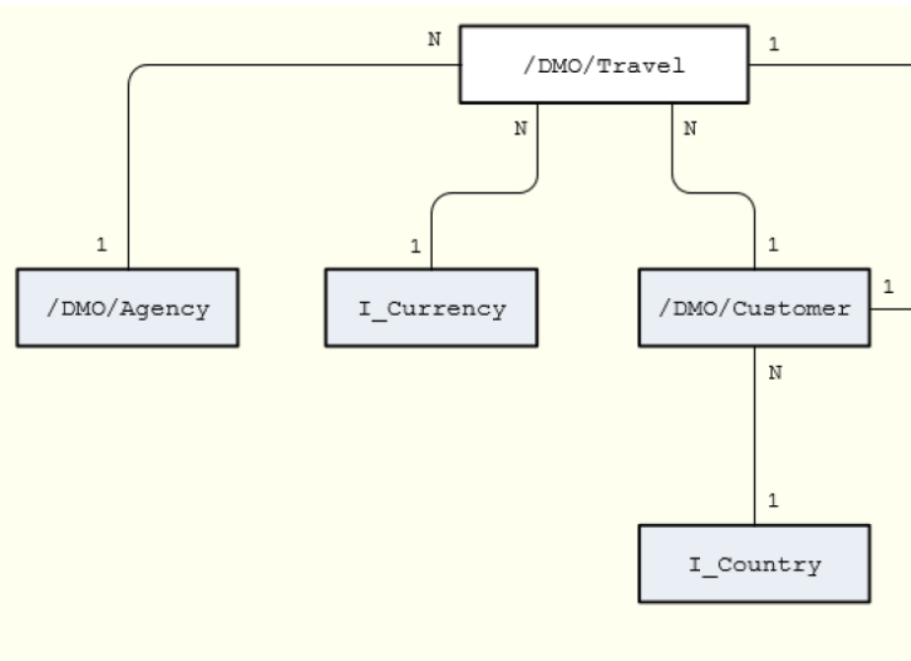
Un-managed Implementation
The scenario described below focuses on an unmanaged implementation type of a business object provider in the context of the ABAP RESTful programming model.
For the unmanaged implementation type, the application developer must implement essential components of the REST contract itself. In this case, all required operations (create, update, delete, or any application-specific actions) must be specified in the corresponding behavior definition before they are manually implemented in ABAP.
The figure below shows the relationships between the travel, agency and customer entities where the travel entity represents the root of the data model. Additional entities for currencies (I_Currency) and countries (I_Country) are generally available in your system and are included in our data model using associations.

Slide 6
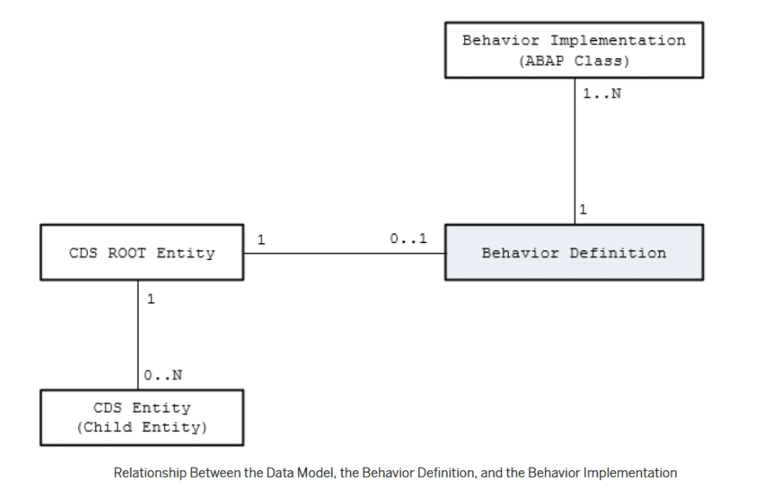
Behavior Definition
A business object behavior definition (behavior definition for short) is an ABAP Repository object that describes the behavior of a business object in the context of the ABAP RESTful programming model.
A behavior definition is defined using the Behavior Definition Language (BDL) and comprises capabilities and modelling aspects of the business object node or nodes, for example the supported operations (such as create, update, and delete actions) or the definition of lock dependencies between the parent and child nodes.
A behavior definition always refers to a CDS data model. This reference results from the name equality with the root entity. This means that a CDS data model must always exist before the behavior definition is created.
A behavior definition relies directly on the CDS root entity.
One behavior definition refers exactly to one root entity and one CDS root entity has a maximum of one behavior definition (a 0..1 relationship), which also handles all associated (child) entities.
The implementation of a behavior definition can be done in a single ABAP class (behavior pool) or can be split between an arbitrary set of ABAP classes (behavior pools). You can assign any number of behavior pools to a behavior definition (a 1: n relationship).

Slide 7
Behavior Pool
The transactional behavior of a business object in the context of the current programming model is implemented in a global ABAP class or classes. These special classes are dedicated only to implementing the business object’s behavior and are called behavior pools.
the implementation of a behavior definition can be done in one class or split across an arbitrary set of ABAP classes.
You can assign any number of behavior classes to a behavior definition (a 1: n relationship). Within a single global class, you can define multiple local classes that handle the business object’s behavior.
The global class is just a container and is basically empty while the actual behavior logic is implemented in local classes.
Local class 1 for Entities
Behavior Definition
Class Pool
Local class 2 for Entities
Local class 3 for Entities

Slide 8
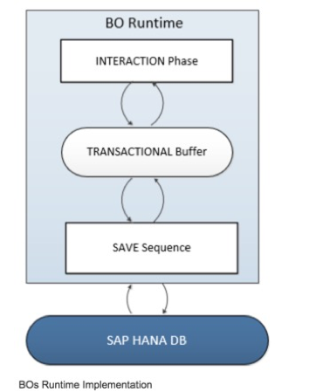
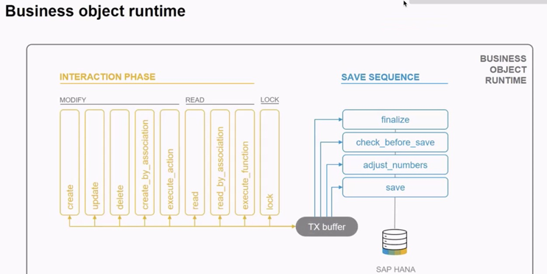
Business Object’s Runtime Implementation
The business object runtime mainly consists of two parts: The first part is the interaction phase where a consumer calls the business object operations to change data and read instances with or without the transactional changes. The business object runtime keeps the changes in its internal transactional buffer which represents the state of the instance data. This transactional buffer is always required for a business object. After all changes were performed, the data can be persisted. This is realized with the save sequence.

Slide 9
What is %CID
%CID stands for the content ID and is used in an OData request to bind the result of an operation to a name so that it can be referenced in another operation later in the transactional processing.
In some use cases, it may happen that a consumer works with data that is not yet persisted and might not have a primary key yet. The primary key can be created in the <method> FOR MODIFY call or later in the save sequence (late numbering). In such cases, a temporary primary key, the content ID (%CID) for an instance, is used as long as no primary key was created by BO runtime. The content ID is consequently also used then as a foreign key.

Slide 10
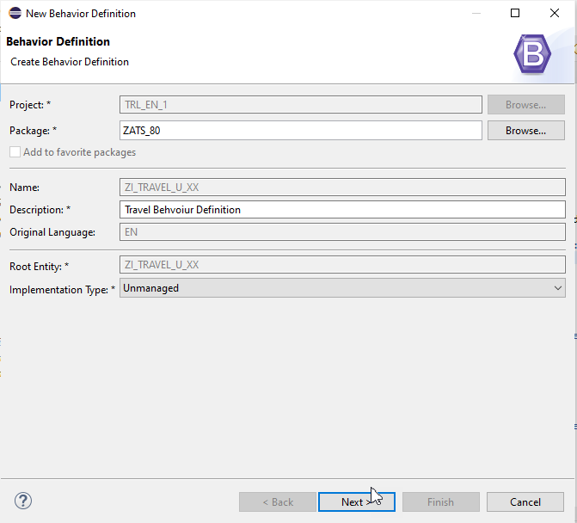
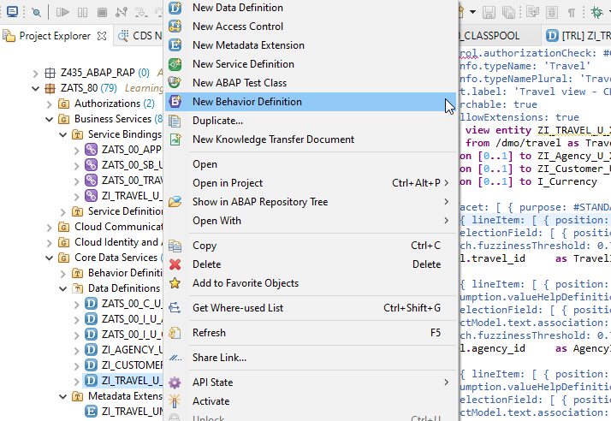
Create of Behavior Definition

Slide 11
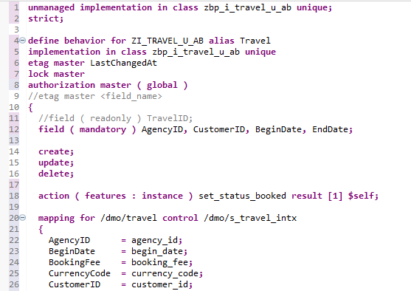
Implementing Behavior Definition
Exercise
Behavior Definition Code

Slide 12
Fiori App
OData
RAP
B-IMP
Legacy Code
post
Agency customer id
Start date
End date
Create
Create IMPORT
Entities (%cid)
Write to TB
messages
save
Save to DB
cleanup

Slide 13
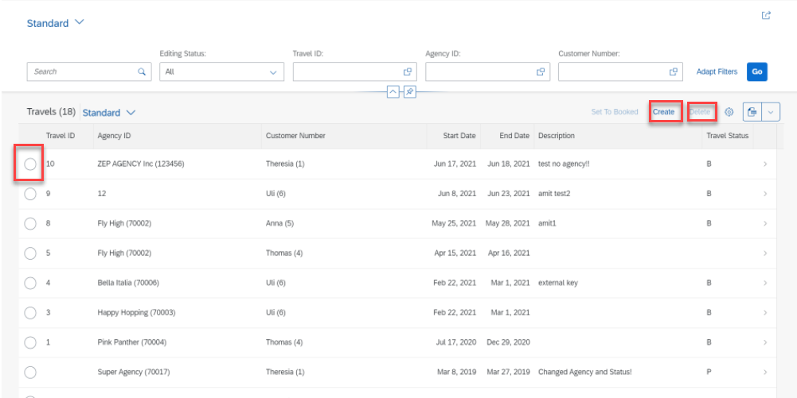
Implementing Create, Update and Delete
For the Functionality of Create ,Update & Delete we Implement the Code in Behavior Definition Class.
Step 1: Click Create Button.

Slide 14
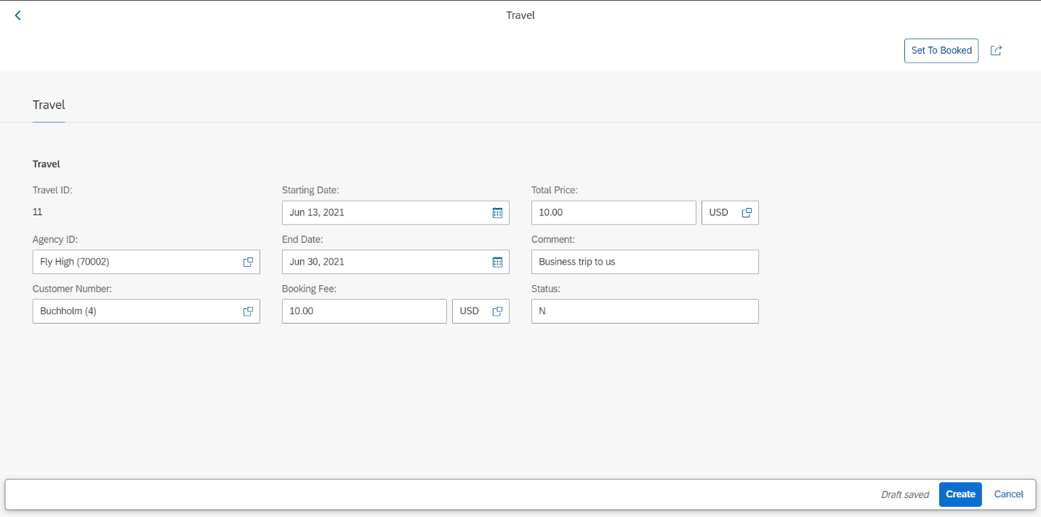
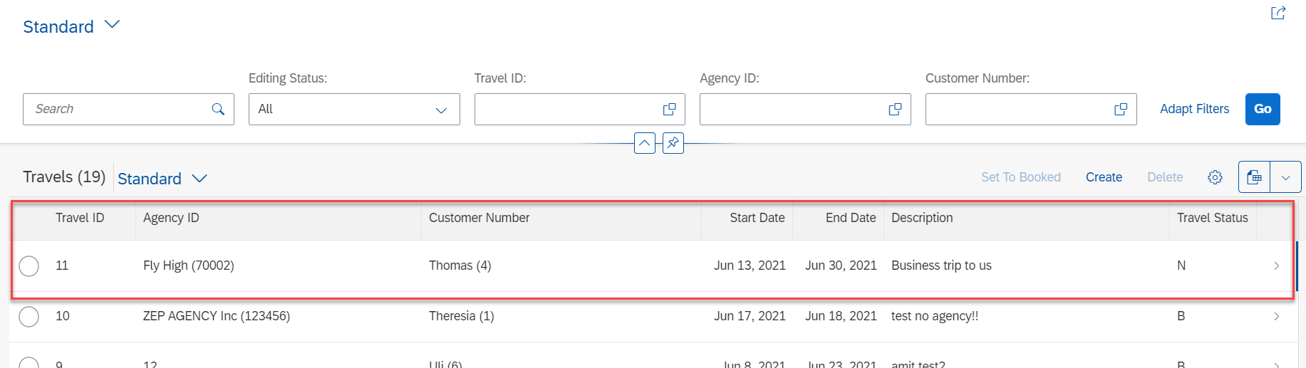
Implementing Create
Step 2: Fill all Correct Entries and Click on Create Button.

Slide 15
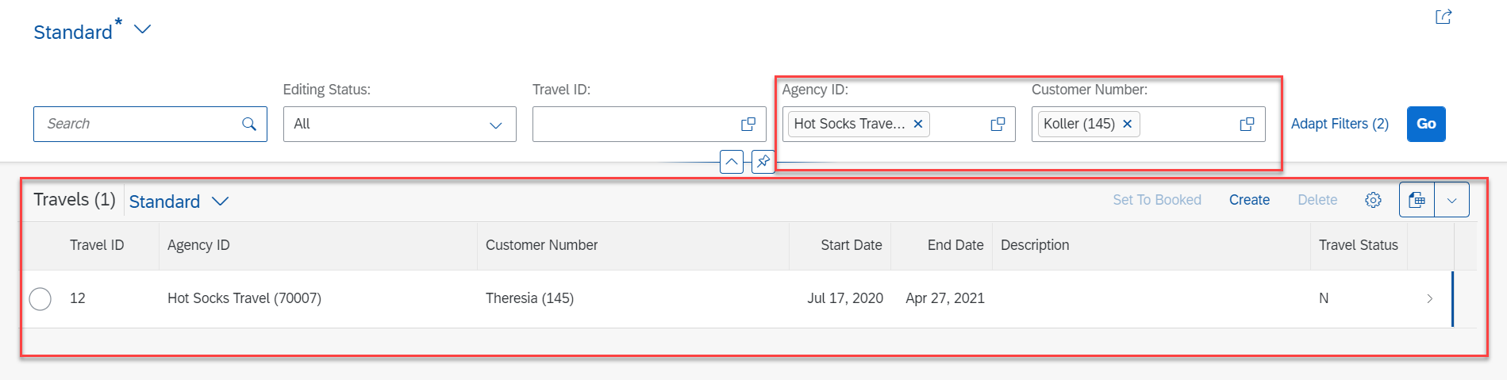
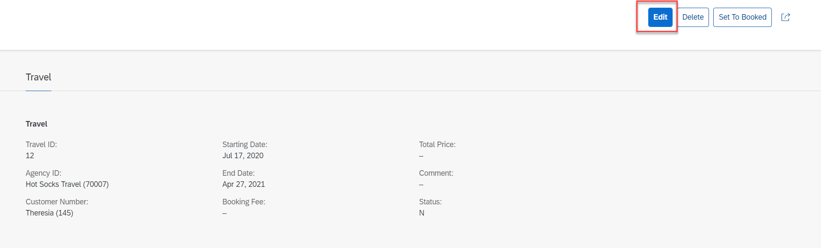
Implementing Update
Step 3: Select a Radio Button and Click Edit Option for Update.

Slide 16
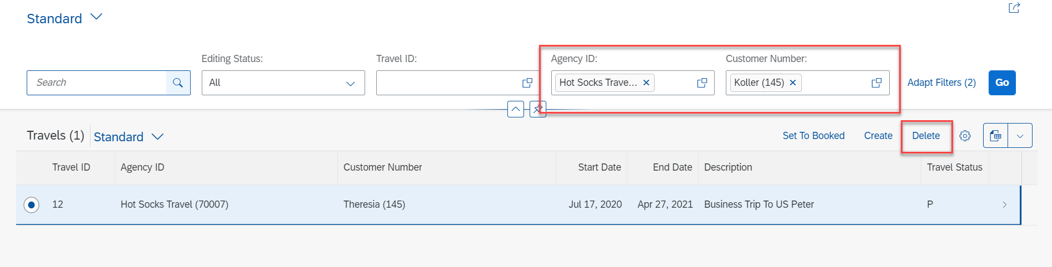
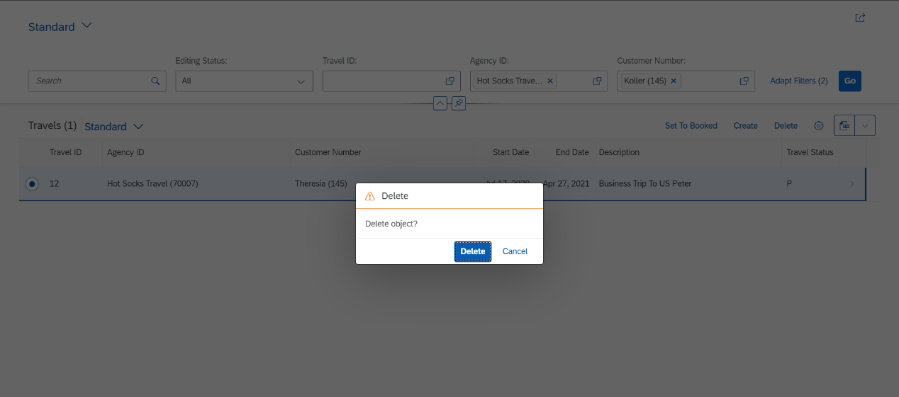
Implementing Delete
Step 4: Select a Radio Button and Click on Delete Button.

Slide 17
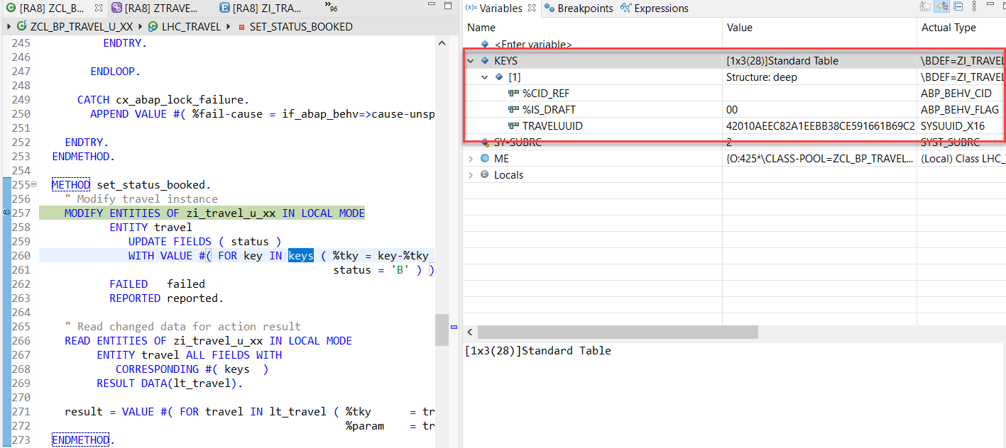
Action Implementation
“Actions” are addition operations in addition to CRUD operations. Are the operations which are non-standard for a business object
Below steps describes the implementation of an action related to the travel instances. Using this action, the end user should be able to change the status of travel processing.
Adding a Type Definition for Import and Export Parameters Required for the Action SET_STATUS_BOOKED
Implementing the Action Handling.

Slide 18
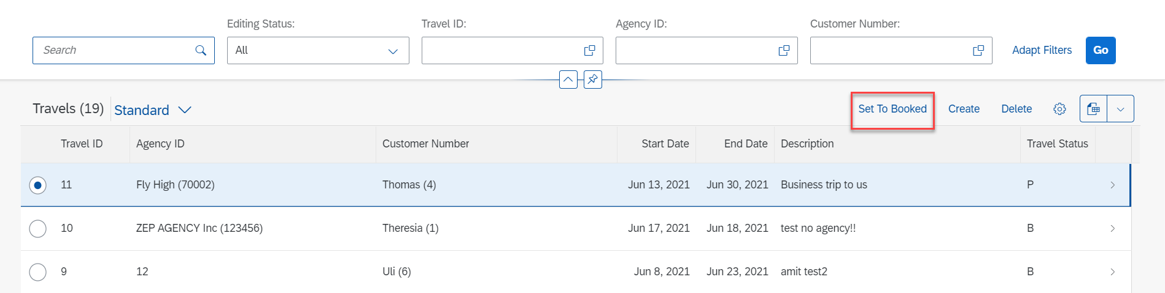
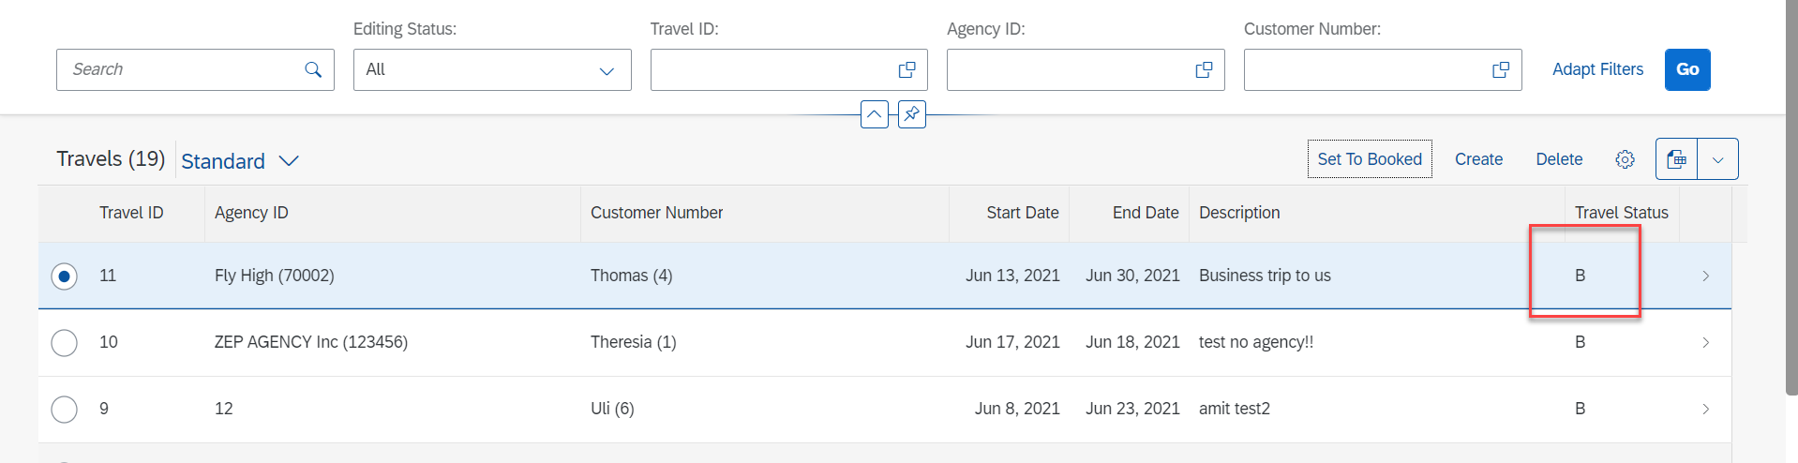
Action Implementation
Select Radio Button and Click on Set To Booked & Travel Status Change to Book (B)

Slide 19
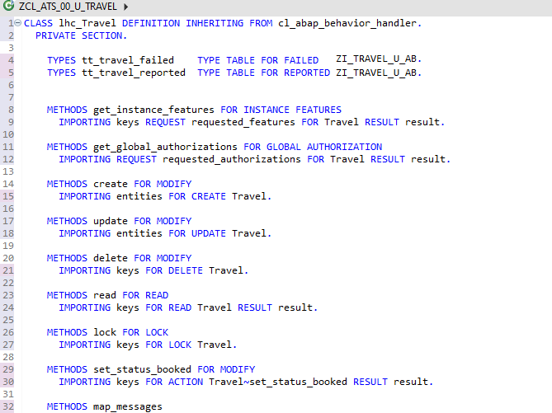
Behavior Pool Logic
Exercise
Behavior Pool Logic

Slide 20
What is EML ?
The Entity Manipulation Language (EML) is a part of the ABAP language that enables access to RAP business objects. Because the consumption of business objects via the OData protocol requires a Fiori UI or a web API, EML enables a type-safe access to business objects directly by using ABAP.
A Business Object in RESTful ABAP is consists of multiple Entities. This is a entity composition tree with one entity acting as a root. EML is part of the ABAP language and used in context of RESTful ABAP to control the BO behavior (create, read, update, delete).
We can use the EML in ABAP to test our BO. We can call the BO using EMP from ABAP program in 2 ways
01
Standard (Statically)
Generically (Dynamic) framework.
02

Slide 21
Syntax of EML
The EML provides us 3 important access statements for Data Manipulation using BO( Business Object ).
01
Perform the CUD ( Create ,Update ,Delete on BO
MODIFY ENTITIES OF RootEntityName
ENTITY EntityAliasName
[ CREATE FROM it_instance_c ]
[ UPDATE FROM it_instance_u ]
[ DELETE FROM it_instance_d ]
[ CREATE BY \AssociationName FROM it_instance_cba ]
[ RESULT et_result_tab ] [ FAILED failed ] [ REPORTED response ] [ MAPPED mapped ]
02
Commit Entities
Will actually persist the changes in the DB from transaction buffer. Any modify operation that are executed within behavior pool or by ABAP program are not causing any DB change because they are applied on transaction Buffer and this buffer content will disappear when ABAP session ends. So if we want the changes to be passed to SAVE SEQUENCE and persisted, we will use the COMMIT ENTITIES statement.
finalize ( )
check_before_save( )
Adjust_numbers( )
Save( )

Slide 22
Syntax of EML
03
Read the Data
All operations that do not need to change the data of an entity are carried out by READ Data.
There 2 types of Read
Read Entity by Key
Read Access to child (association) by parent key
Read Statement always returns the RESULT and you must specify target variable. We can also read the associated entity data using BY \asso_name FROM it_table syntax.
The result of associated data with come in another internal table LINK tab_name, it will always contain the key value pair.
READ ENTITIES OF RootEntityName
ENTITY EntityAlias FROM it_read_condition
RESULT et_result
BY \asso_name FROM it_read_rba
RESULT et_res_rba
LINK et_link_keys
ENTITY EntityAlias FROM it_ins_2…. [ FAILED failed ] [REPORTED reported]

Slide 23

Rule for EML
In addition to the data we also have a compiler generated field in input and output results called %control, this field is responsible to inform the RESTful framework that, which are all the fields we would like to send to DB while creation or update while updating. Also while read we can specify the same to avoid reading everything.
We can also see the complete BO structure in BO Explorer using keyboard shortcut :-
Alt+Shift+W

Slide 24
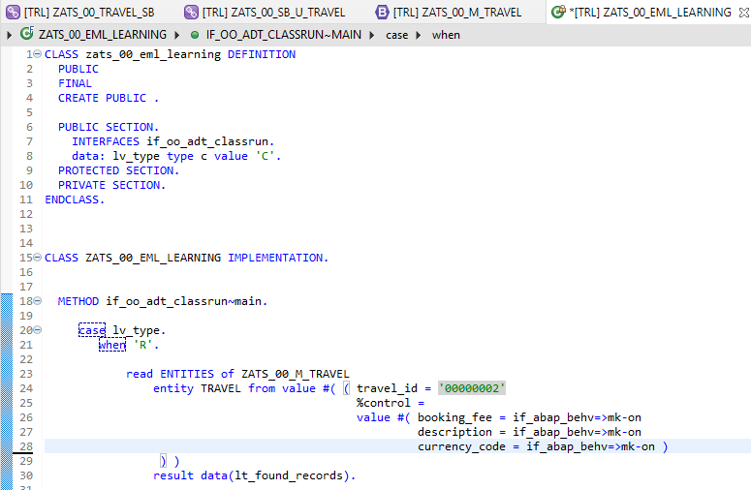
Implementing EML
Exercise
ZATS_00_EML_Learning

Slide 25
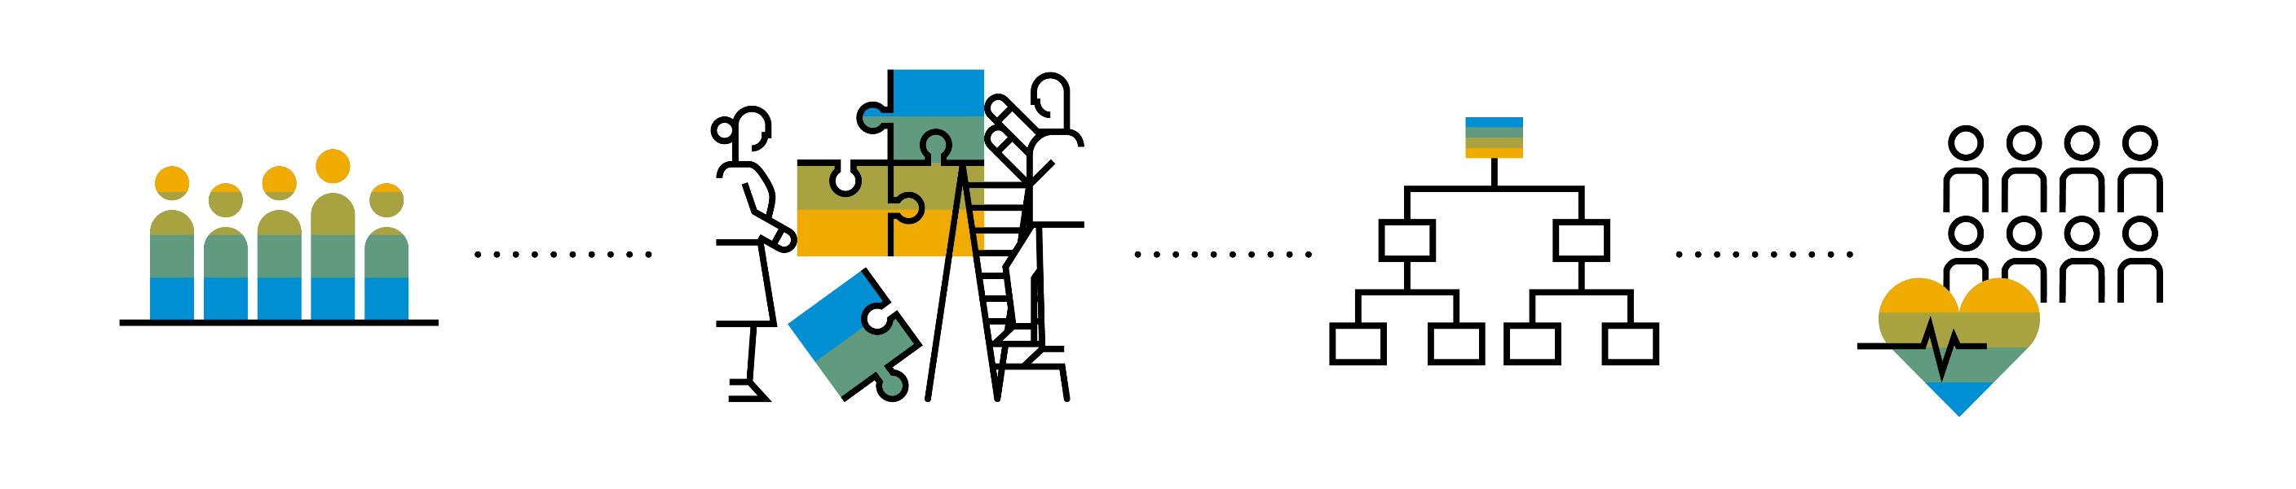
Introduction to Managed Scenario
Let us consider we have been given a green field and asked us to develop a villa from scratch with our own customization. So, what steps will be involved in it? We need to design the floor-plan of the villa, the sections we want to include in the house like pool area, a garden, a jogging track etc. And we will proceed with selecting materials, selecting vendors, enforcing conciliation and orders and many more steps. Similarly, the RAP’s managed scenario provides the greenfield development for our business object.
In the managed scenario, the implementations of behavioral elements like Create/Update/Delete are managed by the RAP framework itself. However, to implement complex logic like validations, determination or some sort of actions (Submit, Approval, Reject etc.) on the business entity, you need to add the ABAP logic for it in implementing classes.

Slide 26
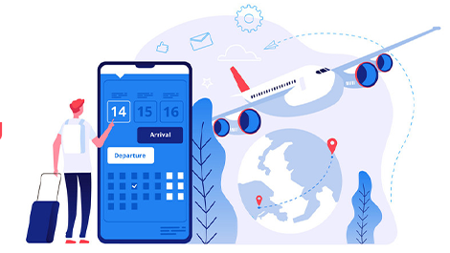


Use Case for Managed Scenario
I am working as a ABAP on Cloud developer for one of the travel planner agency, which has just taken the BTP subscription. They want me to create 2 fiori apps for the travel industry
Processor Application
Approver Application
MakeMyTrip.com
Source → Destination
Start → End Date
How many
Travel Itinerary
Travel Request which has multiple Bookings
Create a travel request and add bookings with all the properties changeable
Updates booking fees and description and provide approvals
Processor
Approver

Slide 27

Steps for Build Use Case
Fiori App for Processor
Fiori App for Approver
Service Def and Binding
Service Def and Binding
CDS Data Model
CDS Projection for Processor @UI
CDS Data Model
CDS Data Model
CDS Projection for Approve @UI
Introduction
1..1
Behavior Def
Projection (processor)
Behavior definition
Behavior definition
Behavior Def
Projection (approver)
Behavior definition
Behavior Implement (pool)

Slide 28
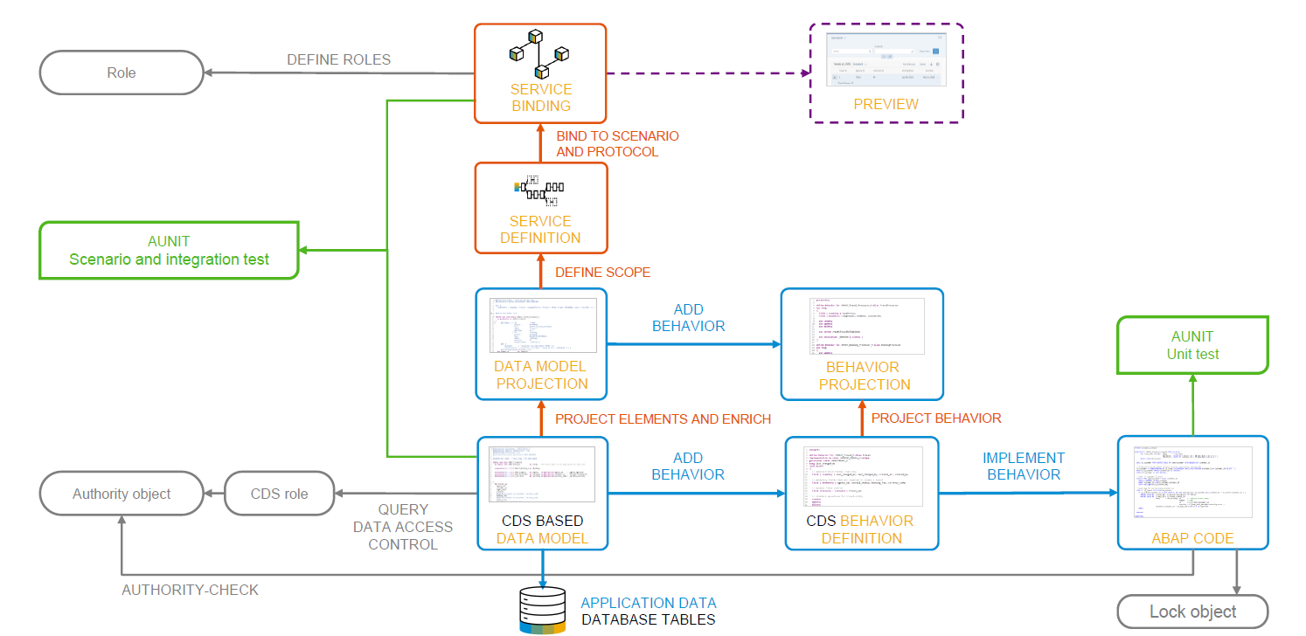
Development flow

Slide 29
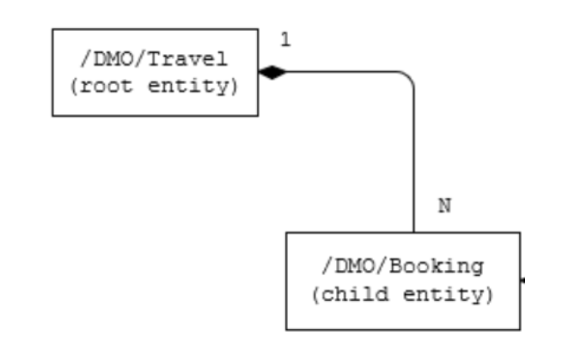
Our new Business Object
From a structural point of view, a business object consists of a tree of entities that are linked by compositions. Every entity in this composition tree is an element that is modeled with a CDS entity. For our demo travel booking scenario, we will implement a 2-level hierarchy composition tree.
As depicted in the figure below, the 2-tier entity hierarchy for managing transactional data in our scenario consists of the following editable entities, with a 1: N cardinality on each level:
Travel
Booking
i.e. each travel instance has 0..N bookings The figure below shows the composition relationship between the travel and the (flight) booking entities, where the travel entity represents the root of the data model.

Slide 30
Calculator
3rd – 6th
Addition, subtraction
Calculator
7 and above
Addition, multiplication, division
1 2 3
4 5 6
7 8 9
0 $
1 2 3
4 5 6
7 8 9
0 $
+
/
+
-
*
Projection
Projection
1 2 3
4 5 6
7 8 9
0 $
/
+
*
-

Slide 31
Our Demo Scenario
This demo scenario uses two projections with a different service scope. The resulting apps represent two role-based approaches to managing travels.
One business object projection uses the BO characteristics and the operations that are relevant for processing travel data. This resulting UI service serves the role of a data processor. The responsible person can enter the information about travels, bookings into the role-based app for processing travel data. This person needs functionality to create, update and delete entries on all three tiers of the business object. In addition, the action CreateByTravelTemplate is designed to facilitate the creation of new travel entries. The instance-bound action reads the values of the selected entry and creates a new entry based on these values with some deviations for the TravelID and the travel dates.
The other business object projection is the basis for a UI service that contains the functionality that is relevant for an approver. Imagine a person, maybe a manager of a travel agency, that approves the data that was entered by the processor. That means, this person sees the travel information and the corresponding booking data. Based on this data, the approver can either accept or reject the travel. For a minimal scope of fields in the travel entity the approver is enabled to edit the values, for example the BookingFee or the Description. The information about bookings is set to read-only for the approver. The approver is not allowed to change the fields of the booking entity.
Processor
Approver

Slide 32
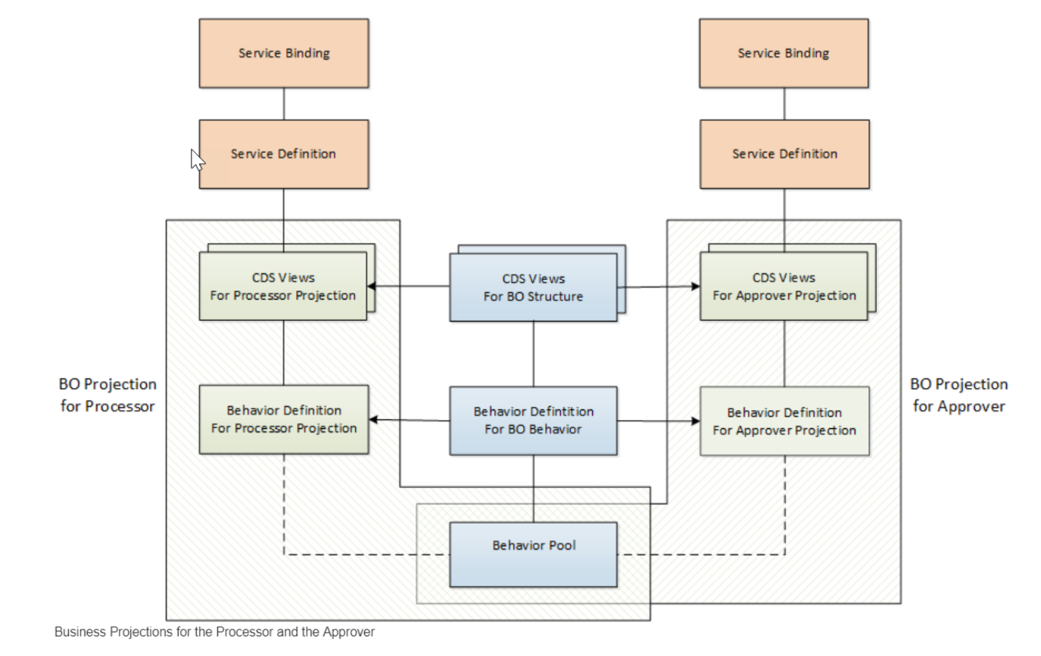
Projections

Slide 33
Introduction – Flexible Service Consumption
For a more flexible service consumption, every transactional business object is projected into a service specific context. In other words, only those elements of the data model and those behavior characteristics and operations that are needed in the relevant business service context are exposed for the service.
By means of projections, you can expose one BO in different business contexts by using different BO subsets. The general business logic is defined in the BO whereas the BO projection adopts a subset of the business logic.
A layering with projections enables robust application programming. You can change or enhance the BO without changing the exposed service as the scope of the service is defined in the projection layer. Enhancing the business object with additional structure or behavior does not have any effect on the resulting service.

Slide 34
Development Flow
4. Imp Behavior Definition on top of Projection View’s of Processor App.
7. Imp Behavior Definition on top of Projection View’s of Approver App.
2. Imp Behavior Definition on Travel.
6. Create Service Binding on top of Service Definition.
10. Create Service Binding on top of Service Definition .
1
3
5
7
9
2
4
6
8
10
1. Create Basic CDS View’s
For Travel & Booking.
3. Create Projection CDS on top of Basic View’s for Processor App.
5. Create Service Definition for Processor App.
7. Create Projection CDS on top of Basic View’s for Approver App.
9. Create Service Definition for Approver App.

Slide 35
Lose coupling
Both entities can co-exist w/o each other
Good to have relation
Tight Coupling
They come together
Must have relation

Slide 36
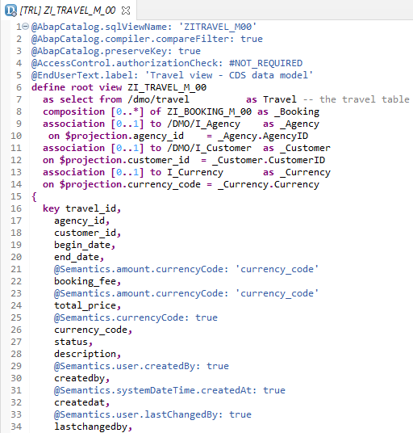
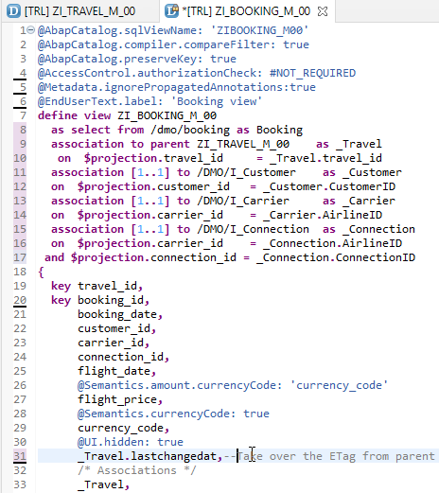
Create Base CDS View
ZI_TRAVEL_M_00
ZI_BOOKING_M_00

Slide 37
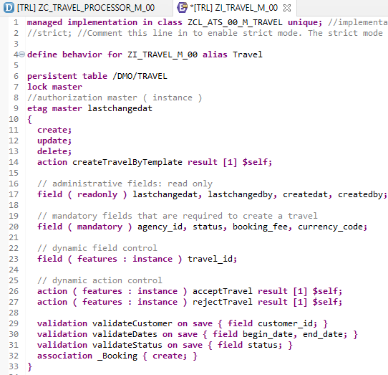
Implementing Base Behavior Definition
In the Project Explorer view of your ABAP project (or ABAP Cloud Project), select the node for the data definition that defines the root entity ZI_TRAVEL_M_XX. Open the context menu and choose New Behavior Definition to launch the behavior definition creation wizard.
“ZI_TRAVEL_M_00”
Behavior Definition for Base CDS’s Views .

Slide 38
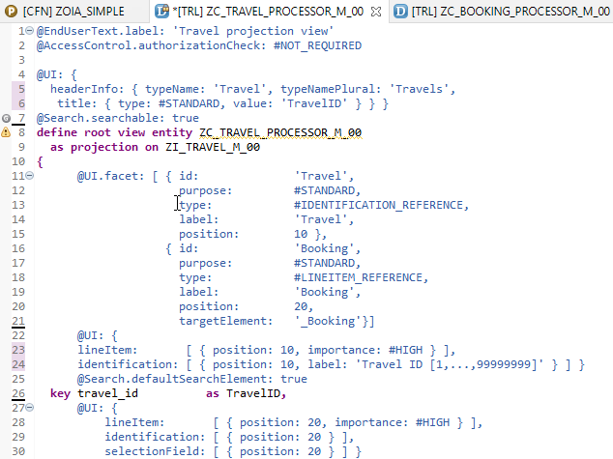
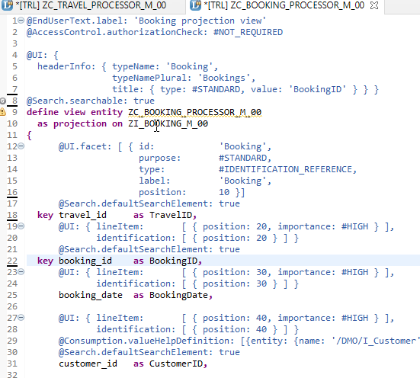
Projection CDS View’s for Processor
Projection CDS View for Travel Info “ZC_TRAVEL_PROCESSOR_M_00”
Projection CDS View for Booking Info “ZC_BOOKING_PROCESSOR_M_00”

Slide 39
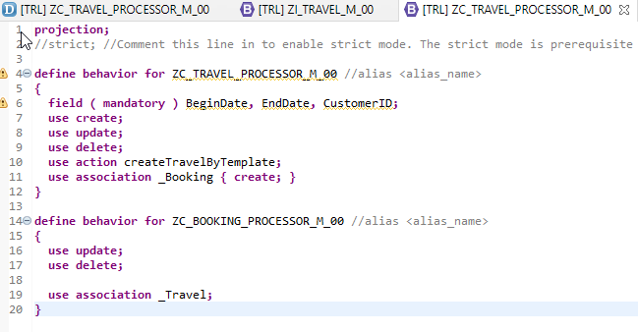
Behaviour Definition for Processor
The behavior for the BO projection is defined in a behavior definition of type projection. The type is defined in the behavior definition header. The projection behavior definition provides the behavior for the projection CDS view. All characteristics and operations that you want to include in the BO projection must be listed explicitly
“ZC_TRAVEL_PROCESSOR_M_00”
Behavior Definition for Projection CDS’s Views of Processor.

Slide 40
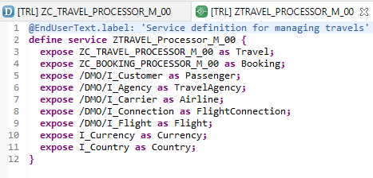
Service Definition
The service definition is a projection of the models and related behavior that you want to expose. In a service definition, you define the OData service to determine which CDS entities are part of the service. This service is then bound to a protocol and to either a UI technology or an A2X service by a service binding artifact. A service definition can be integrated in various protocols without any reimplementation.
Exercise
“ZTRAVEL_PROCESSOR_M_00”
Service Definition for Expose Entity

Slide 41
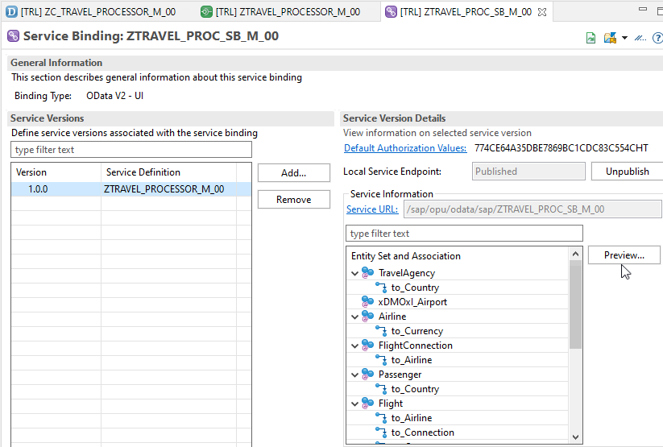
Service Binding (OData)
A service binding implements the protocol that is used for the OData service. It uses a service definition that projects the data models and their related behaviors to the service.
After Creating Service Binding , Select Entity and Click on Preview

Slide 42
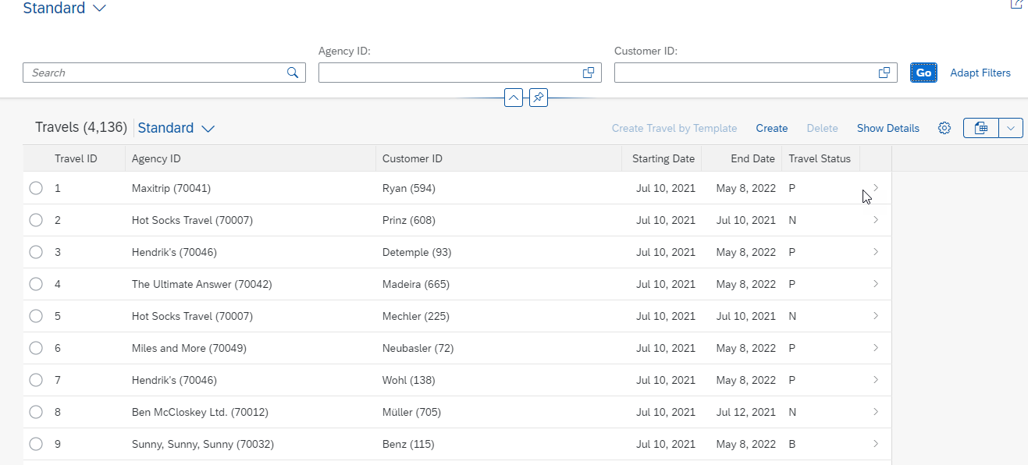
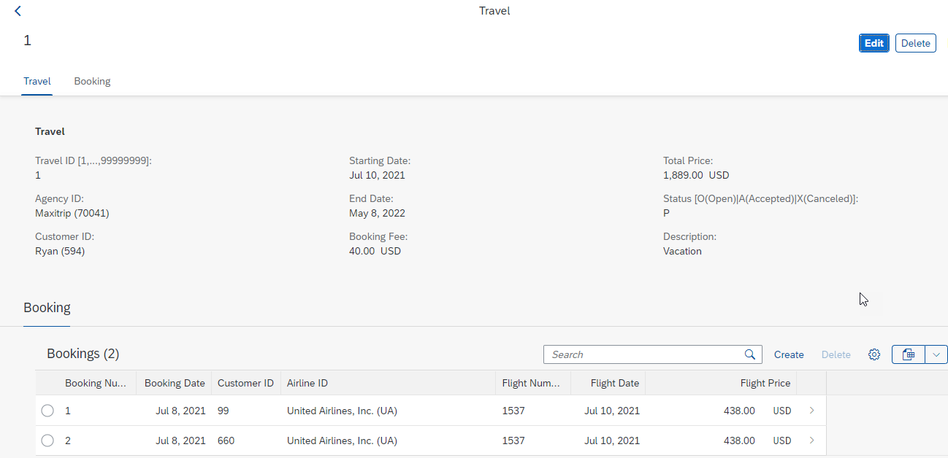
Final Result of Processor App
1st Screen with Search Bar & Filter Bar
2nd Screen with Travel and Booking Data,
& C-R-U-D Functionality

Slide 43
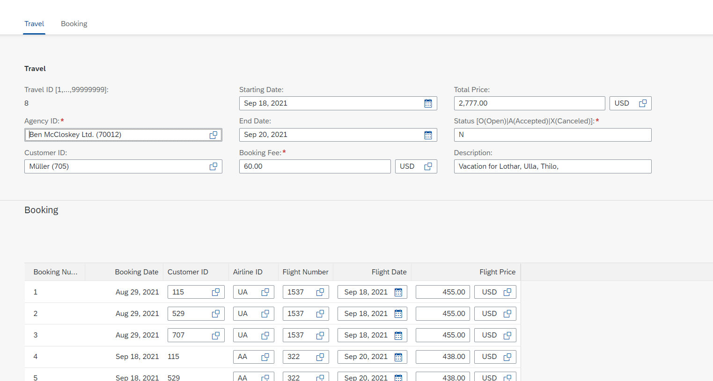
Testing composition
We should be able to create Travel request with bookings.

Slide 44
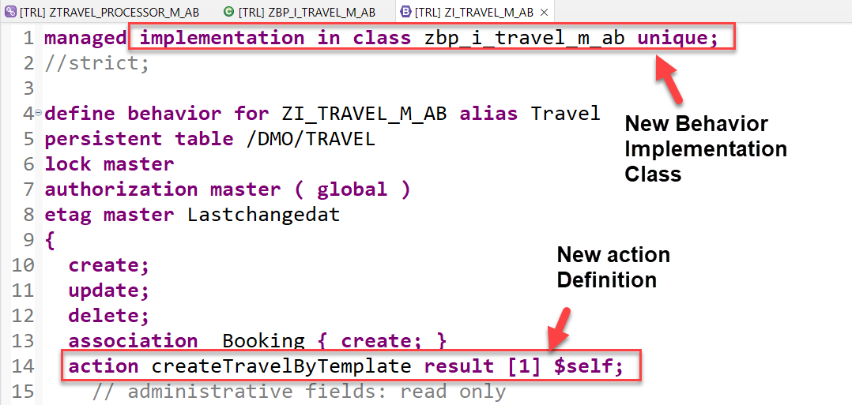
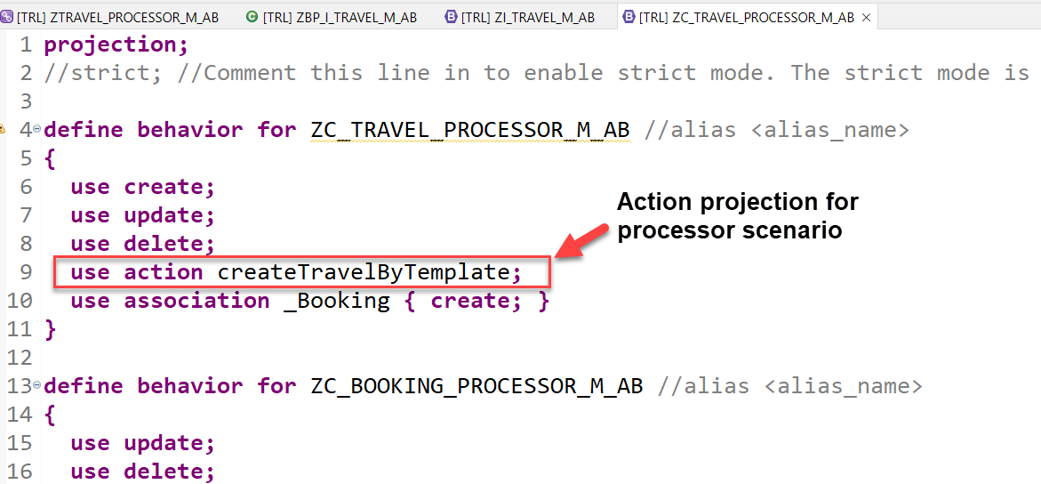
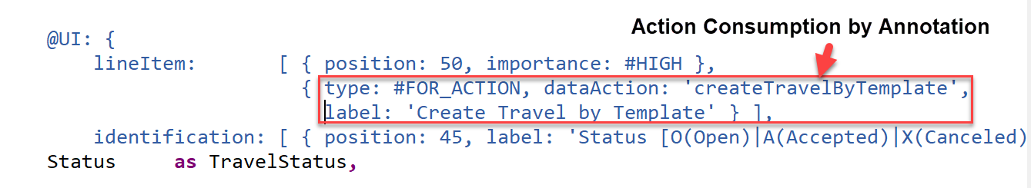
Implementing Action “createTravelByTemplate”
This action provides a template for creating a new travel based on an already existing travel instance.
Exercise
Create Travel By Template Action Code

Slide 45
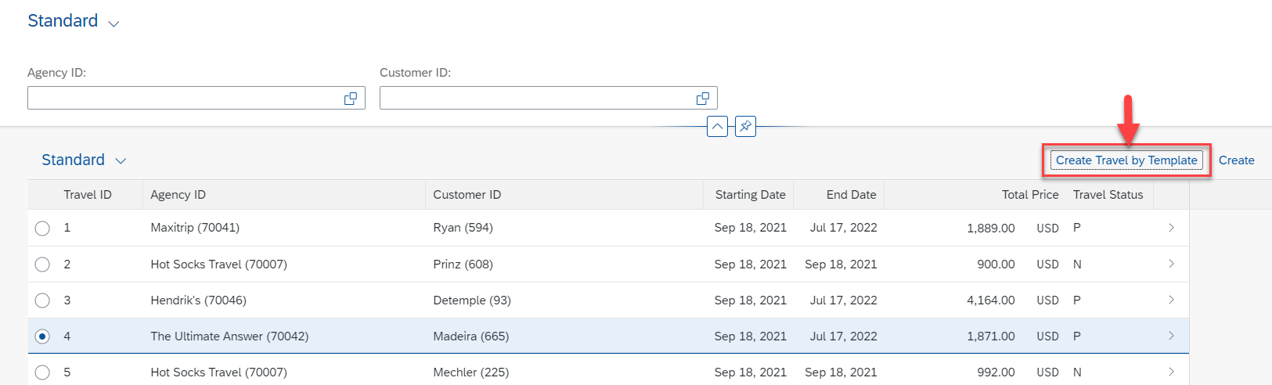
Result of Action Implementation
Check how the UI of a Fiori application looks like or refresh the browser where Fiori app is displayed.

Slide 46
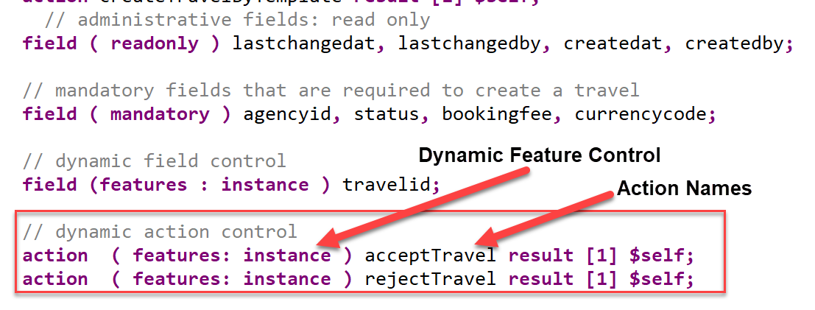
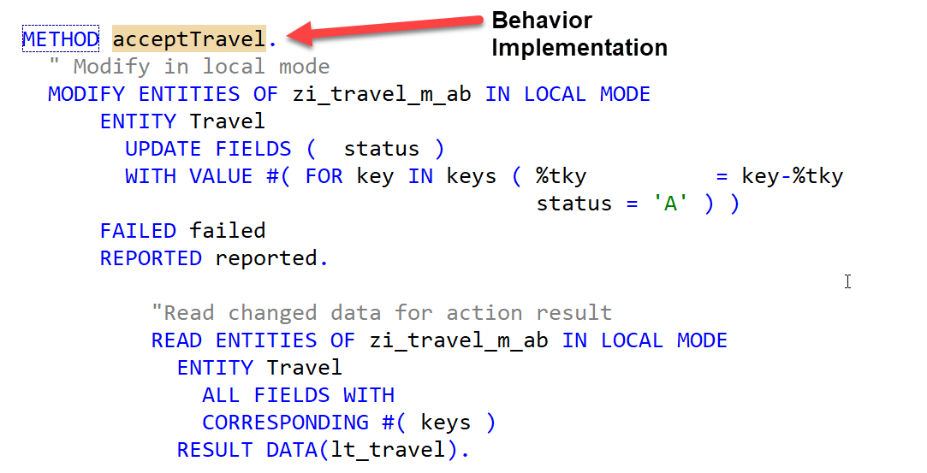
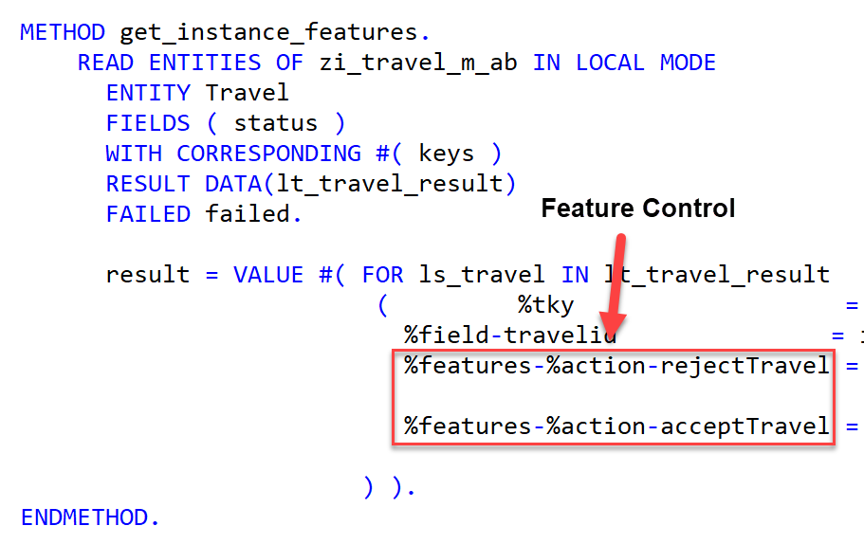
Implementing Action “approve/rejectTravel”
These 2 actions are going to be used later in approver scenario and also have dynamic feature control
Exercise
Approve/Reject Action Code

Slide 47
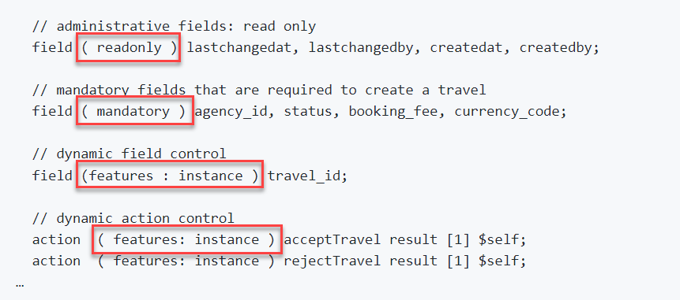
Modeling Static and Dynamic Feature Control
As an application developer you may want to determine, which entities of your business object should be create-, delete- and update-enabled, so that they can be modified during consumption using EML or OData services. In addition, you also may want control which (UI) fields of an entity are read-only or which actions in which usage scenarios are enabled or disabled for execution by the end users.
In ABAP RESTful programming model, the feature control is precisely the means of accomplishing such tasks. It allows you to control the visibility and changeability of fields, operations or entire entities.
Depending on whether feature control refers to specific instances or is independent of each entity instance, we distinguish between instance-bound and static feature control.
The availability of feature control values is modelled in a behavior definition. Unlike static, instance-bound feature control requires not only a definition but also an implementation in a handler class of the behavior pool. Therefore, we also talk about dynamic feature control in case of instance-bound feature control.
Both, static and dynamic feature control is defined for different levels (entity, field, or action level) in the behavior definition by using the following syntax:
Exercise
Dynamic Feature Control Code

Slide 48
Requirements
Make Administrative fields for Travel as Read Only
Make Travel Fields Mandatory for booking
Control the Accept and Reject Travel actions based on status
Make Connection fields mandatory for Booking
Control the Customer ID field based on Carrier, For AA make it Read only

Slide 49
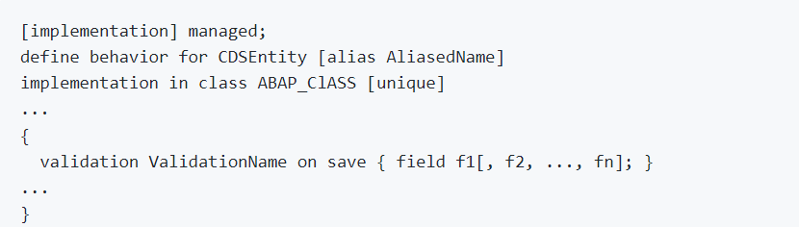
Implementing Validations
A validation is an implicitly executed function intended to check the data consistency of an existing instance of an entity (consistency validation). It is implicitly invoked by the business object’s framework as soon as a trigger condition at a predefined point in time is fulfilled. Validation can return messages to the consumer and reject inconsistent instance data from being saved.
Validations never modify any instance data but return the messages and keys of failed (inconsistent) entity instances.
Validations are specified for individual business object’s entities in the behavior definition by using the following syntax:

Slide 50
F1
F2 1 → 2
F3
Save
If f1 is not initial
If f2 is not initial
select * checktable where exist f2
If f3 is not initial
check itab has f3

Slide 51
Use case for Validation
Check if the customer ID referenced in the Travel order is valid.
Check if the travel end date is more than Travel Start Date
Check if the status passed by User is valid.
These validations are assigned to the "Travel" entity having defined update as the trigger operation on entity "Travel". As soon as data is updated by the consumer, the validation will check it and return a warning message if the unusual condition arrives.
Exercise
Validation Code

Slide 52
Implementing the Determination
A determination is an implicitly executed function that handles side effects of modified entity instances. It is invoked by the business object’s framework as soon as a determination’s trigger condition at a predefined point in time, the determination time, is fulfilled.
Determinations are triggered internally based on changes made to the entity instance of a business object. The trigger conditions are checked by business object framework at different points during the transaction cycle, depending on the determination time and the changing operations on the relevant entity instances. For each determination, it is necessary to specify both the determination time and the changes that form the trigger condition. A trigger condition consists of a list of fields belonging to the same entity the determination is assigned to and the changing operations that include creating or updating entity instances. We call this operations trigger operations.
In case a field is changed (after creation or update), the condition is fulfilled. The framework evaluates the triggering condition of all determinations at certain points in time (determination time). For determinations, this is today either after each modification or during the save phase.
You can use a determination primarily to compute data that is derived from the values of other fields. The determined fields and the determining fields either belong to the same entity or to different entities of a business object.
As a result, determination can modify entity instances and return transition messages (error, warning, information, success).

Slide 53
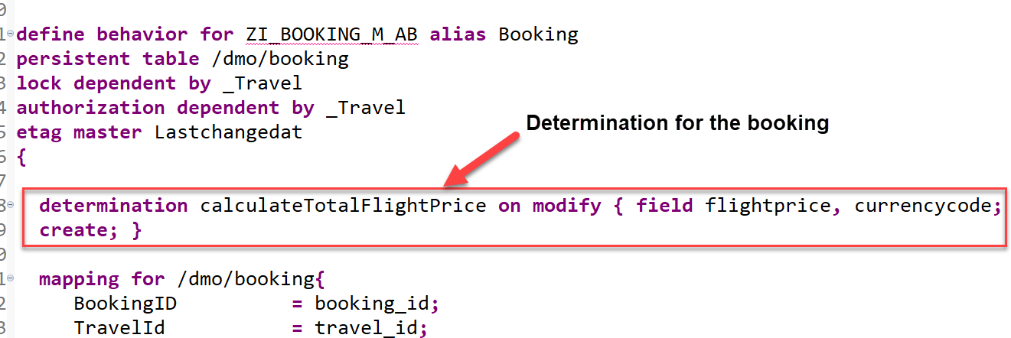
Implementing the Determination
The determination calculateTotalFlightPrice on the booking entity is intended to handle the calculation of total price of all flight bookings that belong to the selected travel.
The determination will be triggered by on modify as determination time when creating new booking instances or updating the flight price value or when changing the currency. In other words: both fields flight_price and currency_code serve as trigger fields and form together with create and update operations the trigger condition for the determination.

Slide 54

End of Day 04
Trainer: Anubhav Oberoy

Slide 55
Trainer: Anubhav Oberoy

Slide 56
THANK YOU
If you cannot do
great things, do small things in a great way.
Anubhav Oberoy
https://www.anubhavtrainings.com

Slide 57


We’re committed to empower you to be
Most Desirable Resource
through powerful training solutions.
We build the workforce of the future.
250+
Corporate Clients
30,000+
Learners Trained
25000+
Learners Placed
FREE WEBINARS
Sign up for free webinars with industry experts every fortnight!
Enroll Now!
Contact us today!
https://anubhavtrainings.com/

Slide 58




More from AnubhavTrainings.com

